Slide 1

Let’s start with Allah Yaar
Bs in Computer Science

Slide 2
Modern Computing
Modern computing refers to advancements in computing technologies that enable faster, efficient, and innovative ways to process, store, and communicate information.

Slide 3
Modern Computing
Key Features of Modern Computing
Cloud-based Services: Use of cloud storage and applications (e.g., Google Drive, Dropbox).
Mobile Computing: Accessing computing resources via portable devices like smartphones and tablets.

Slide 4
Modern Computing
Artificial Intelligence and Machine Learning: Systems that can learn and make decisions (e.g., recommendation systems).
Distributed Systems: Computing tasks spread across multiple systems (e.g., blockchain technology).
Example: A global company uses distributed cloud servers to ensure users can access their website without delays regardless of location.

Slide 5
Virtualization and Emulation
Virtualization
Virtualization is the process of creating virtual instances of resources like hardware, software, or storage.

Slide 6
Virtualization and Emulation
Types:
Hardware Virtualization: Using a single physical machine to run multiple virtual machines (VMs). Example: VirtualBox allows users to run Linux on a Windows system.
Storage Virtualization: Abstracting physical storage to create a unified storage pool. Example: A company consolidates its data storage across multiple servers.

Slide 7
Virtualization and Emulation
Emulation
Emulation mimics the behavior of one system on another.
Purpose: Run applications meant for one platform on another.
Examples:
A PlayStation emulator allows gamers to play PlayStation games on a PC.
Mobile device emulators help developers test apps without using physical devices.

Slide 8
Cloud Computing
Definition
Cloud computing involves delivering computing services—like storage, processing power, or software—over the internet.

Slide 9
Cloud Computing
Characteristics:
On-Demand Access: Resources can be accessed anytime.
Scalability: Services can grow or shrink based on user needs.
Pay-as-You-Go Model: Users pay only for what they use.

Slide 10
Cloud Computing
Types of Cloud Computing
Public Cloud: Shared infrastructure offered to multiple organizations. Example: Amazon Web Services (AWS).
Private Cloud: Dedicated infrastructure for a single organization. Example: A bank using a private cloud for sensitive data.
Hybrid Cloud: A combination of public and private clouds. Example: A company stores non-critical data in a public cloud but keeps sensitive data in a private cloud

Slide 11
The Deep Web and Dark Web
Deep Web
The deep web refers to parts of the internet that are not indexed by standard search engines (e.g., Google).

Slide 12
The Deep Web and Dark Web
Characteristics:
Contains private data like medical records, bank information, and subscription content.
Requires login credentials or specific software to access.
Example: Accessing your email inbox via a login portal is an interaction with the deep web.

Slide 13
The Deep Web and Dark Web
Dark Web
The dark web is a small part of the deep web that requires special tools, such as the Tor browser, to access. It is often associated with anonymity and illegal activities.

Slide 14
The Deep Web and Dark Web
Characteristics:
Used for anonymous communication.
Can host marketplaces for illegal goods.
Example: Anonymous forums or black markets selling counterfeit items.

Slide 15
Bitcoin
What is Bitcoin?
Bitcoin is a decentralized digital currency that operates on blockchain technology.
Features:
No central authority or banks.
Transactions are verified by network nodes through cryptography.
Uses blockchain to maintain transparency and security.

Slide 16
Bitcoin
How Bitcoin Works
Wallet: Users store Bitcoin in digital wallets.
Blockchain: All transactions are recorded on a public ledger.
Mining: Specialized computers solve complex algorithms to verify transactions.
Example: Bitcoin allows cross-border payments without involving banks, useful for sending money internationally.

Slide 17
Virtual Reality (VR) and Augmented Reality (AR)
Virtual Reality (VR)
VR creates a completely immersive digital environment.
Characteristics:
Requires VR headsets like Oculus Rift or HTC Vive.
Used in gaming, training simulations, and virtual tours.
Example: A VR app lets users explore historical landmarks without physically visiting them.

Slide 18
Virtual Reality (VR) and Augmented Reality (AR)
Augmented Reality (AR)
AR overlays digital content on the real world through devices like smartphones or AR glasses.
Applications:
Gaming: Pokémon GO overlays virtual Pokémon in real-world environments.
Education: AR apps display 3D models of human anatomy for medical students.

Slide 19
The Internet of Things (IoT)
Definition
IoT refers to a network of interconnected devices that communicate and share data over the internet.
Key Features:
Sensors collect and transmit data.
Devices can be controlled remotely.

Slide 20
The Internet of Things (IoT)
Applications of IoT
Smart Homes:
Devices like smart thermostats, lights, and security cameras can be controlled through smartphones.
Example: Amazon Alexa or Google Nest adjusts home temperature based on user preferences.

Slide 21
The Internet of Things (IoT)
Healthcare:
Wearable devices monitor patient health and transmit data to doctors.
Example: Fitbit tracks physical activity and heart rate.
Industrial IoT (IoT):
Sensors monitor manufacturing processes to improve efficiency.
Example: A factory uses IoT to detect machine malfunctions.

Slide 22
The Internet of Things (IoT)
Applications of IoT
Transportation:
IoT enables smart traffic systems and autonomous vehicles.
Example: Tesla cars use IoT to update software and enable autonomous driving.

Slide 23
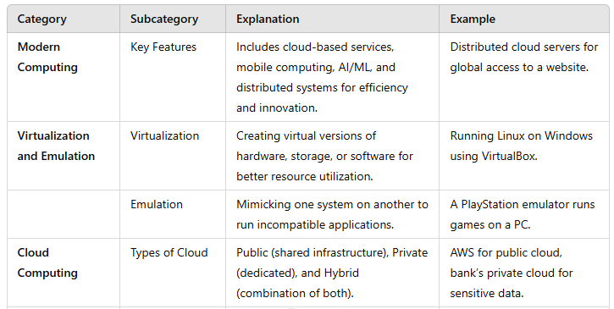
Summary Table

Slide 24
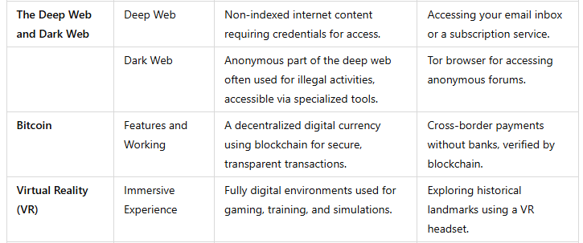
Summary Table

Slide 25
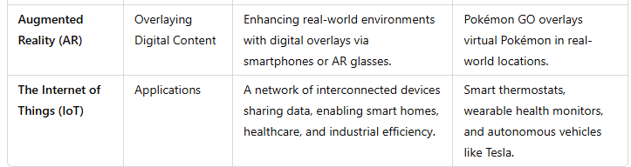
Summary Table

